Slide 1
IDM 212: UI Design 2
Week 01:
The Mobile First User Interface Design Process & Responsive Web Design

Slide 2
Project:
Redesign a responsive News (or similar) website.
Notes:
NyTImes, Boston Globe, Wall Street Journal are all pretty typical examples of a news site. Any site focused on articles that is constantly being updated will work; smashing magazine, sports illustrated, engadget, ...

Slide 3
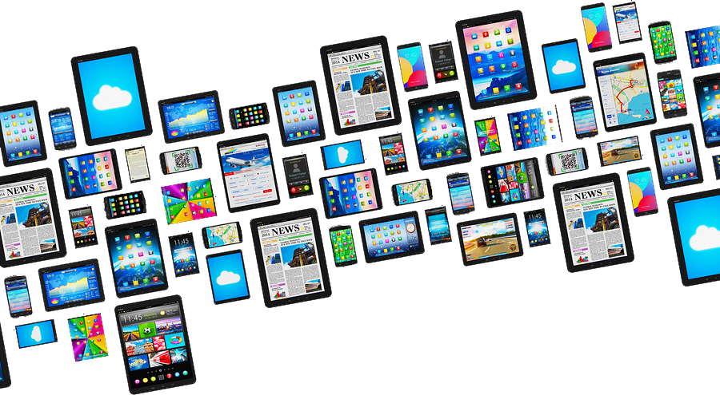
Which
Device (screen size)
Operating System
ISP (download speed)
Browser
will you reader be using to access your content?
?
Notes:
Operating systems define fonts, color spaces, resolution etc…
ISP defines speed, DSL, Cable Modem, FiberOptics, 4G, 3G, Edge…. DialUp
Browsers introduce rendering quirks, IE, Safari, Chrome, Firefox, Opera, (desktop v mobile…)
The truth is you have no control over what your user chooses to use to access your content

Slide 4
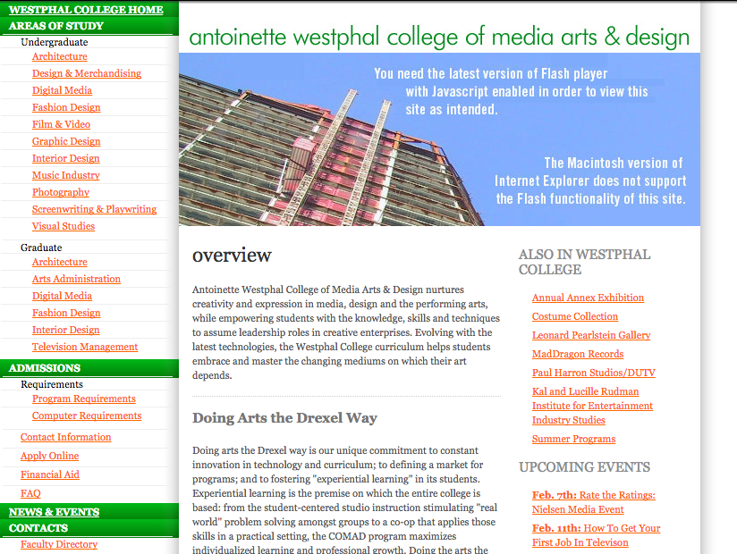
Desktop Browsers
Monitors grew from 800px to 1024px. We eventually settled on designing for 960px width for design
Notes:
Last term we learned how to design for the desktop. When the world wide web started most monitors were 800x600, they slowly grew and we kept changing our web design widths until we settled on 960px wide as an industry standard (1024 + 32px padding on each side)

Slide 5
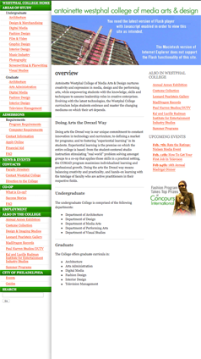
SmartPhone Browsers
Then smartphones came along in 2007 and changed everything. No mouse, no hover states, and only 320px wide with a slow connection.
Notes:
Then smartphones came along in 2007 and changed everything. No mouse, no hover states, and only 320px wide with a slow connection. Suddenly our designs weren't working on them

Slide 6
Device Fragmentation in 2017
24,093 Distinct Android devices
1,294 Device brands
10 Android operating systems in use
https://opensignal.com/reports/2015/08/android-fragmentation/
Notes:
A lot changed from 2007 to 2016. We saw tablets, phablets, and tons of new sized, systems, etc….

Slide 7
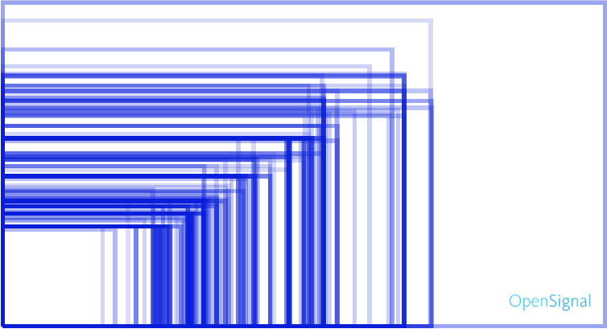
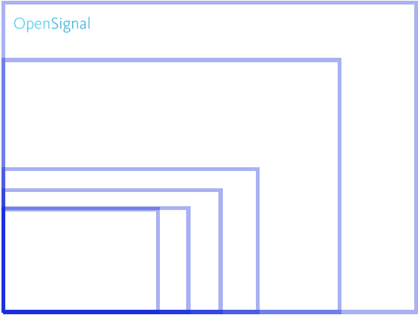
Device Screen Sizes in 2017
Android Apple
Notes:
These are all the different screen sizes across the two main platforms as of 2015, these are shown in landscape, so rotate them 90 for portrait mode and we double the screen widths. There were also an insane number of screen sizes, so how do we design for all of them?

Slide 8
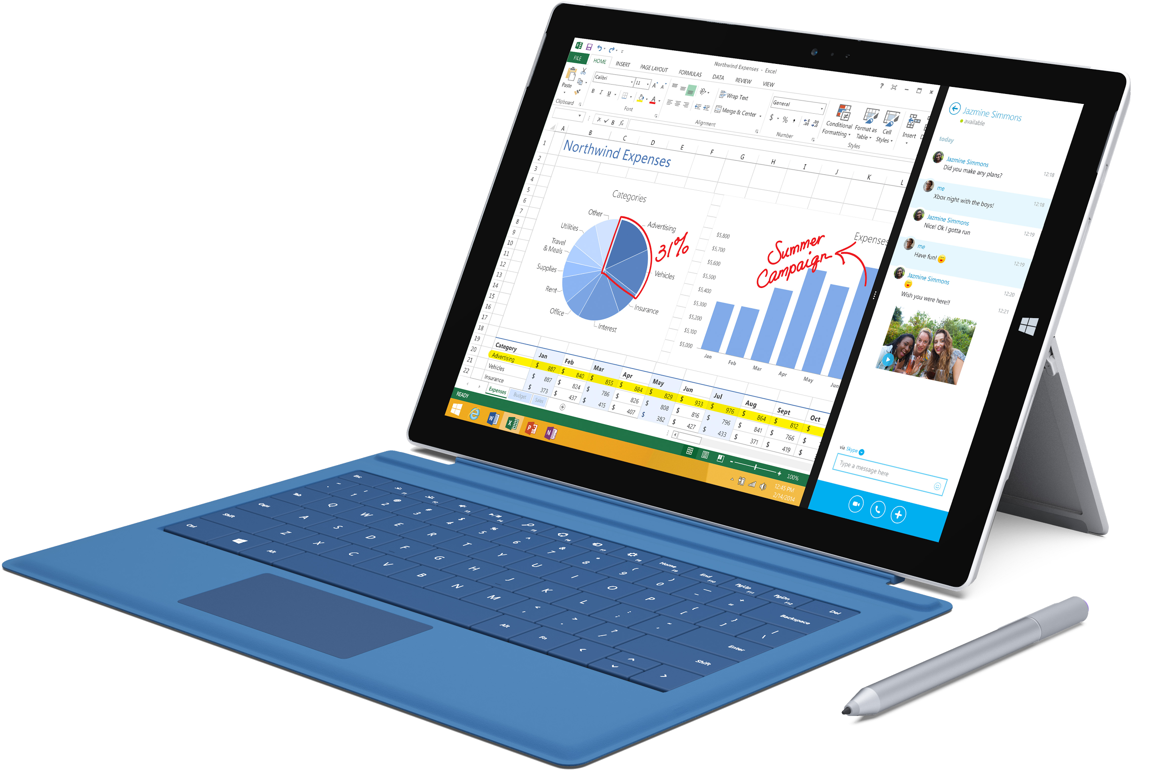
Microsoft Surface Pro 3
runs Windows 8
touch screen & stylus
physical keyboard
resolution 2160 x 1440
Notes:
Does anyone have one of these? What is this? Is it a desktop, a tablet? How do we design for it? What is coming out next week?

Slide 9
Mobile First &
Responsive Web Design
Notes:
Right now current industry standard is to combine two theories/approaches
So what do these terms mean? Anyone know?

Slide 10
Definitions
Mobile First
The mobile-first approach is exactly as it sounds: designing for the smallest screen and working your way up.
Responsive Web Design (RWD)
RWD is an approach to web design aimed at allowing desktop webpages to be viewed in response to the size of the screen or web browser one is viewing with.

Slide 11
Focus on the content
Notes:
Right now current industry standard is to combine two theories/approaches
So what do these terms mean? Anyone know?

Slide 12
Mobile First
Content Inventory
Visual Hierarchy
Design for smallest screen then scale up
Enlarge touch targets
No hovers
Think 'app'
Avoid large graphics
Notes:
1. Content Inventory — Create a spreadsheet or equivalent document containing all the elements you want to include.
2. Visual Hierarchy — Prioritize the elements in the content inventory and determine how to display the most important elements prominently.
3. Design with the smallest breakpoints and then scale up — Build the mobile wireframe first, then use that as the model for larger breakpoints. Expand the screen until there’s too much white space
4. Enlarge touch targets — Fingers are much wider than pixel-precise mouse cursors, and so need larger elements on which to tap. At the time of this writing, Apple recommends 44 pixels square for touch targets. Give hyperlinks plenty of space, and slightly enlarge buttons, and make sure that
5. Don’t count on hovers — It almost goes without saying, but designers often rely on hover and mouseover effects in their interactive work. If you’re thinking mobile-friendly, don’t. There is no hover control for fingertips yet.
6. Think “app” — Mobile users are accustomed to motion and a modicum of control in their experience. Think about off-canvas navigation, expandible widgets, AJAX calls, or other elements on the screen with which users can interact without refreshing the page.
7. Avoid large graphics — Landscape photos and complex graphics don’t display well when your screen is only a few inches across. Cater to mobile users with images that are readable on handheld screens.

Slide 13
Mobile First
Mobile comes with a natural set of constraints that may at first seem limiting. Screens are small, connections are slow, and people often only give you their partial attention or short bursts of their time.
Designing for mobile first forces you to embrace these constraints to develop an elegant mobile-appropriate solution. But the benefits go well beyond mobile. Small screen sizes force you to prioritize what really matters to your customers and business.
Notes:
dont let yourself be intimidated by mobile constraints. focus on content priority. then on the core elements of the design

Slide 14
Mobile First = Content First
Think of your site’s content devoid of any interface. Ask yourself why anyone would care about it. If you can’t confidently answer that question, I’m afraid no design, no matter how adaptive, can help you.
Structuring content first creates content focus and hierarchy. It’s about constructing your message and telling your story in a way that’s meaningful to your users and is cohesive in whatever context they may be in. It’s preparing your content to go anywhere.
Notes:
if you were going to set all the content in 12pt helvetica, and read top to bottom what order would you put it in? what is most important? its not interaction. it is meaning for the contents existence

Slide 15
The Core Tenets of Responsive Web Design (RWD)
Media Queries
Flexible Grid
Fluid Images & Video

Slide 16
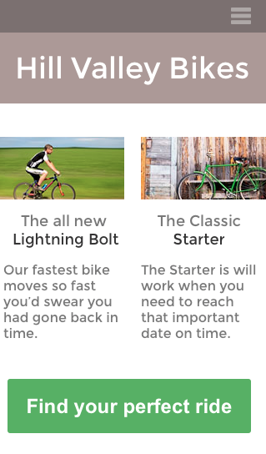
SMARTPHONE VIEW
Thinking mobile-first forces us to think about what’s really important. In a smartphone view, the top-selling item or a new product can lead directly to business goals, so can we leave other items for inside pages. The final call to action is especially prominent and easy to hit with a single tap of the finger.

Slide 17
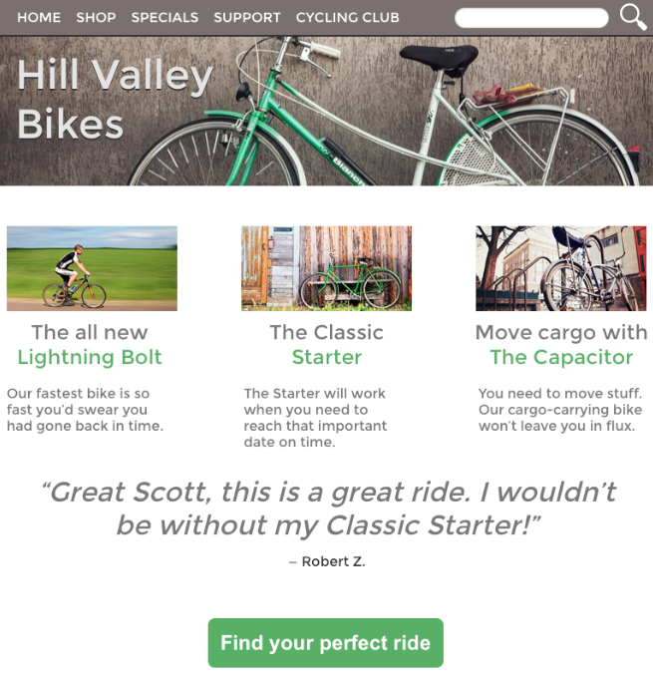
TABLET VIEW
As we design for a tablet-sized view, we’re better able to add secondary information. We can also expand the navigation at the top of the page.
Because more options are available, this can be surprisingly more difficult than deciding what to include in a smartphone UI. The difference between secondary and tertiary elements is a blurry line, and temptation is strong to include everything.
Resist the urge. Use the ordered content list. Like smartphones, space is still limited.

Slide 18
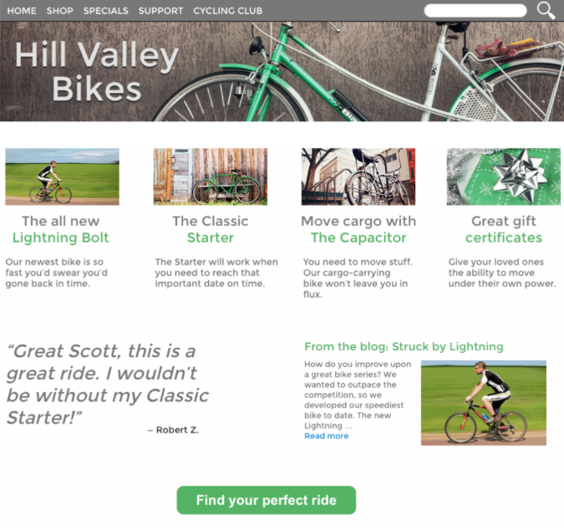
Desktop View
Finally, the desktop view can support as much information as you decide is important. This is where the home page can accommodate all of the information you see fit, whether or not it fits.

Slide 19

Common Breakpoints
320px :: smartphone
768px :: tablets
960px :: desktops
Notes:
There are more for horizontal vs vertical layout on mobile devices, and also for large screen format, but we will be focusing on these three for this class.

Slide 20
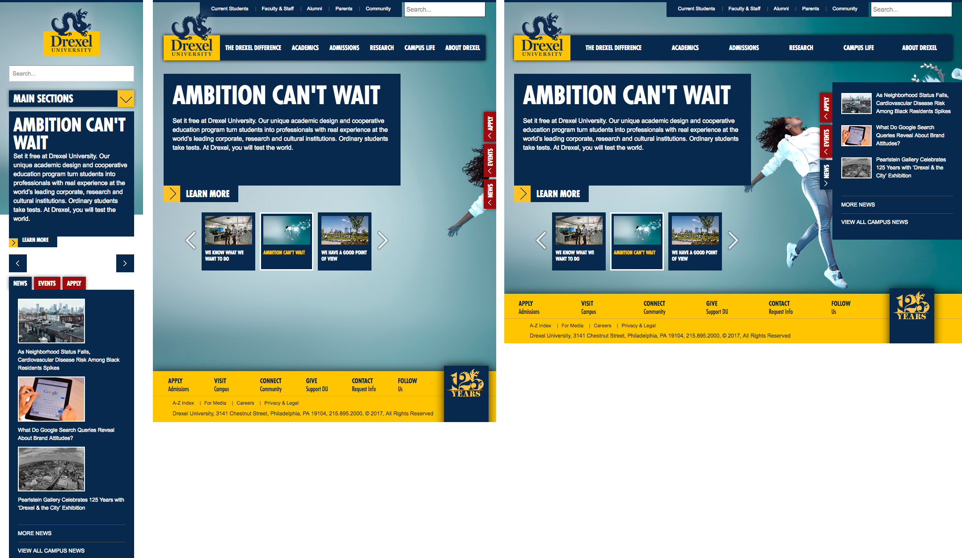
Notes:
Drexels website is responsive

Slide 21
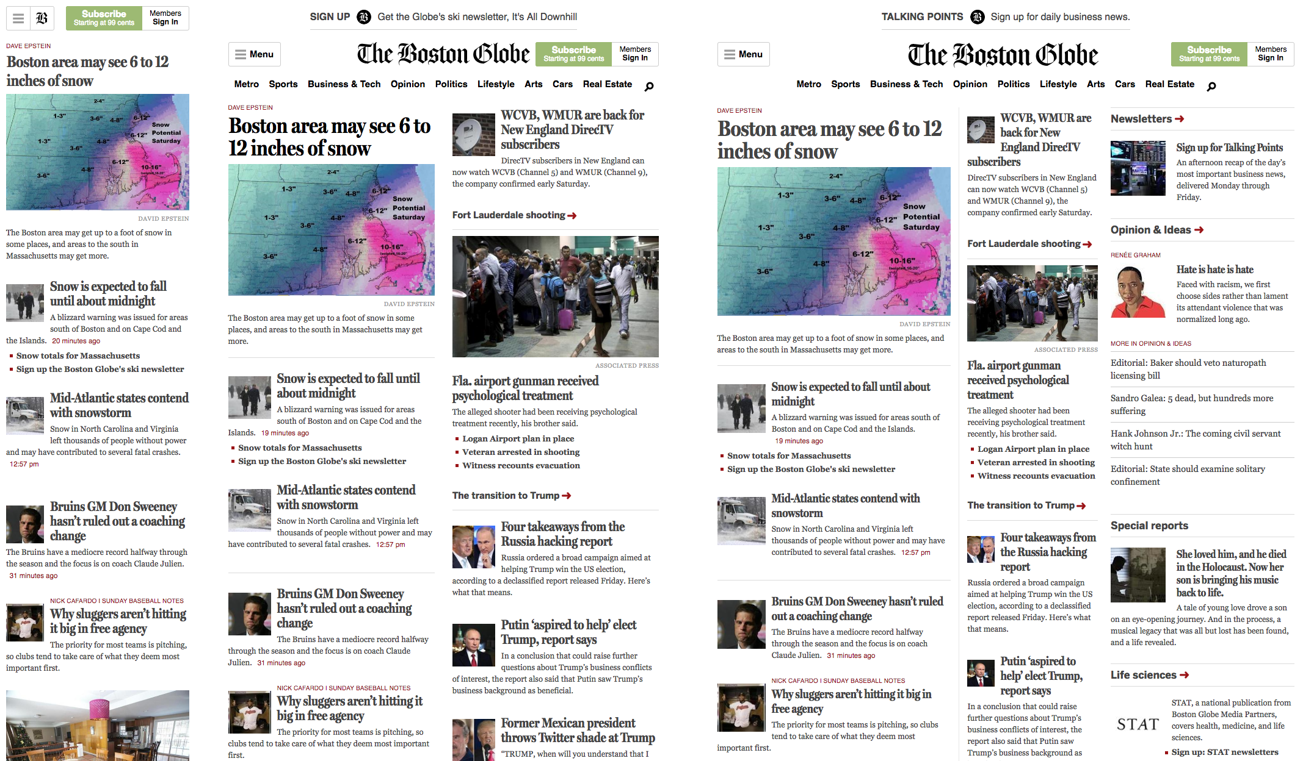
Notes:
The boston globe was wone of the first and most reknowned websites to go RWD

Slide 22
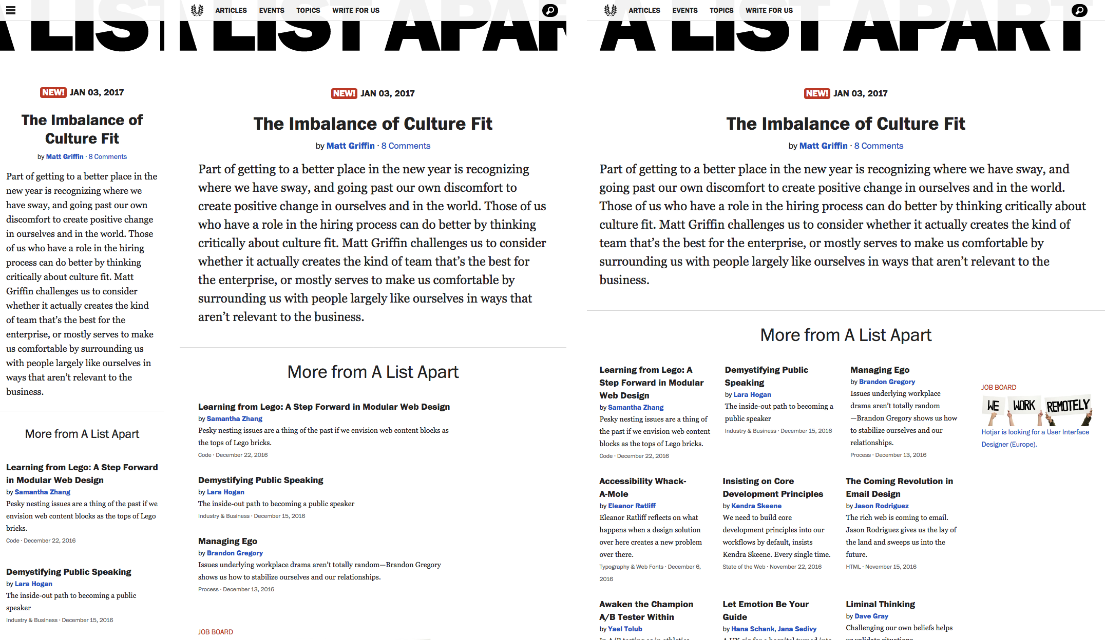
Notes:
A list apart (where rwd was first introduced)

Slide 23
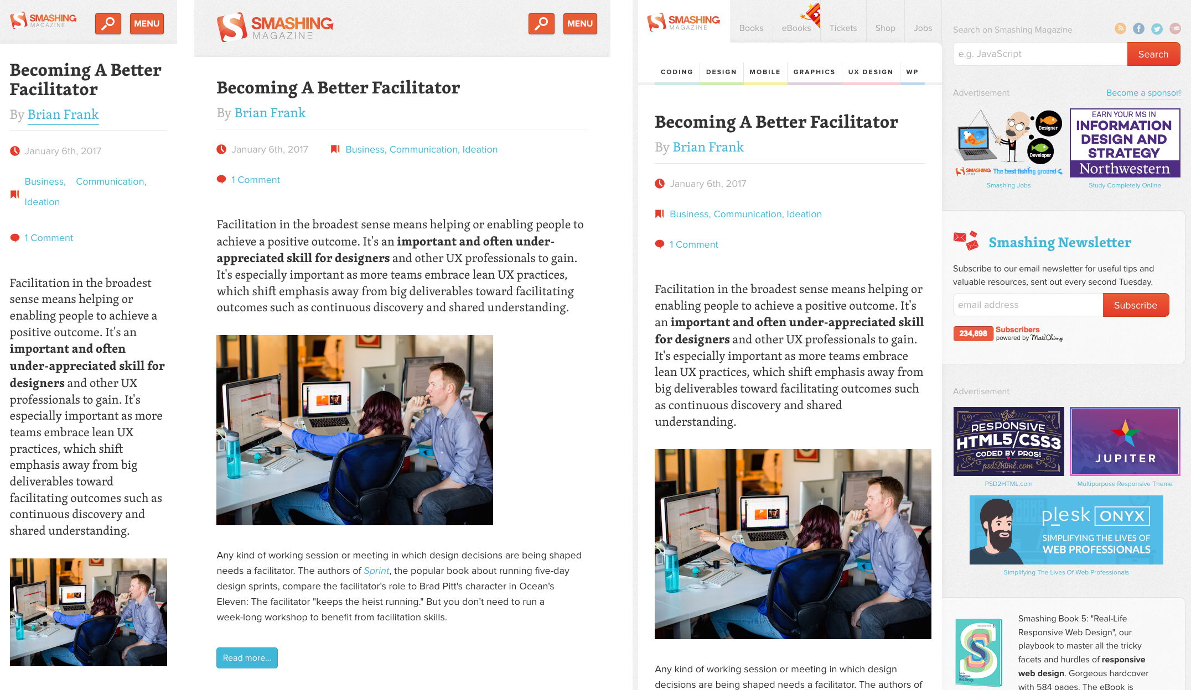
Notes:
Smashing amgazine

Slide 24
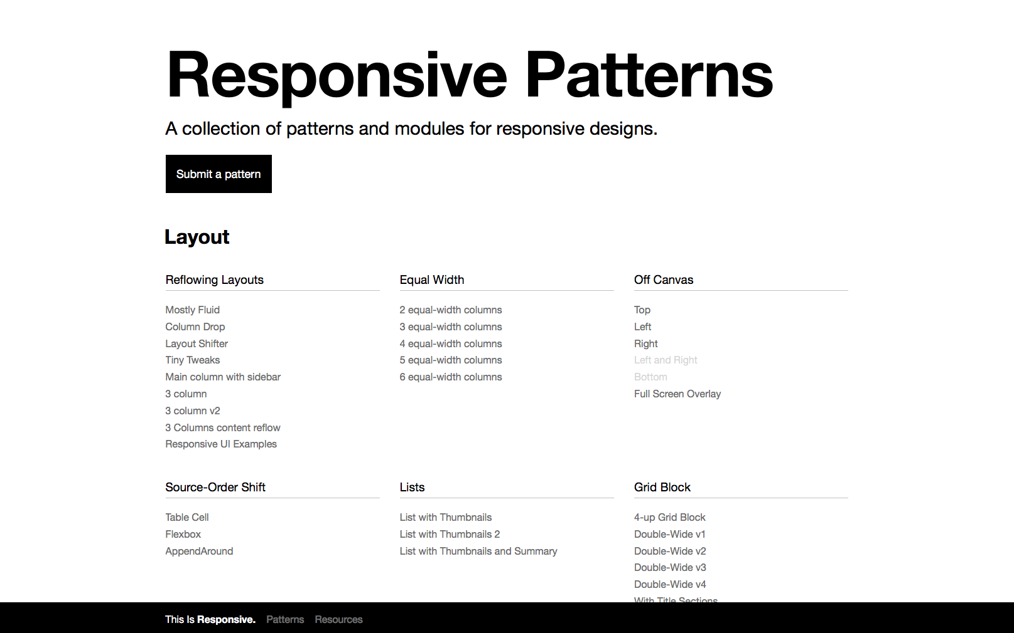
This Is Responsive!
This is a great resource to see a bunch of different design patterns for a variety of different content modules.
http://bradfrost.github.io/this-is-responsive/patterns.html
Notes:
This is a great resource to see a bunch of different design patterns for a variety of different content modules.

Slide 25
Design in the Browser?
This means using HTML & CSS to render design the way your design software works.
The browser is fluid by nature. if you set a documents worth of text with no css the text will automatically be rendered fluidly.
Interactivity is missing with static comps, animations hover states, transitions…
So why design static comps?

Slide 26
Why Design static comps?
It is a quick way to get the general ideas flushed out.
With a well designed workflow, testing and revising design ideas can actually be quicker with a prototyping tool.

Slide 27
Why Design static comps?
In the old days we would pitch three different home page designs to get a client to sign off on one design direction. We would go through a number of revisions on the design, see a few more pages then with final approval we would move into code.
These days every step of the design process is communication.We talk about strategic goals for the project, and how the use of color, type, images, and content organization helps reach these goals. You need to have transparency in your design process.

Slide 28
As an industry, we sell websites like paintings. Instead, we should be selling beautiful and easy access to content, agnostic of device, screen size, or context. If you can get your client to believe in the process, they won’t care what the site looks like.
http://danielmall.com/articles/the-post-psd-era/

Slide 29
Emphasize process. Don’t look for approval, seek agreement and consensual understanding.
Notes:
Show them that you are thinking strategically and open to input. You need to be as flexible as your design.
Instead of the big reveal, you work towards the big inclusion.

Slide 30
Wireframe for Content

Slide 31
Content Analysis
Define the distinct content areas.
Think about what each area is for, not what it is currently holding.

Slide 32
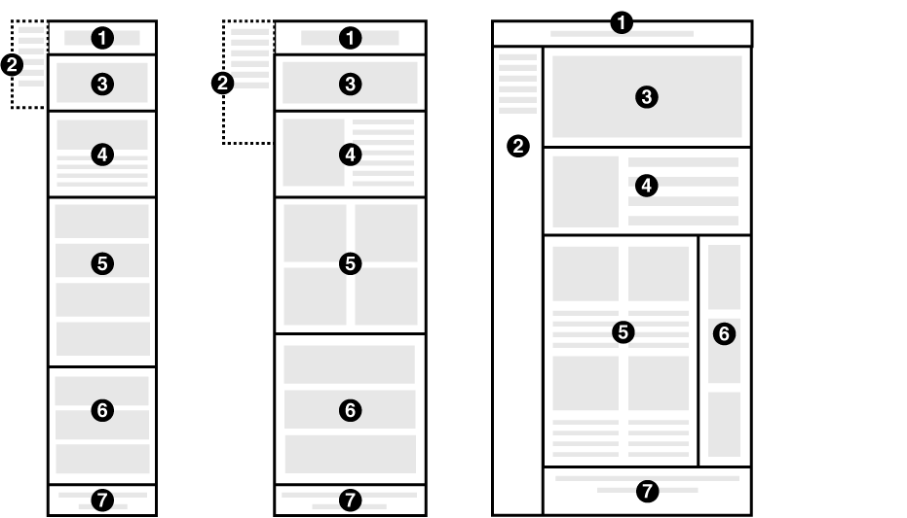
Notes:
Not a lot of detail is needed at this point in the wireframes. A few simple grey boxes for photos/videos, grey lines for text. Mainly I will be looking for how you defined the areas, and an understanding of why they exist on the site.

Slide 33
Capturing Full Pages in Browser
Resize My Browser
http://resizemybrowser.com
Chrome Extension: Full Page Screen Capture
https://goo.gl/fCnsuK
Notes:
These will be helpful for your first weeks homework

Slide 34
Research

Slide 35
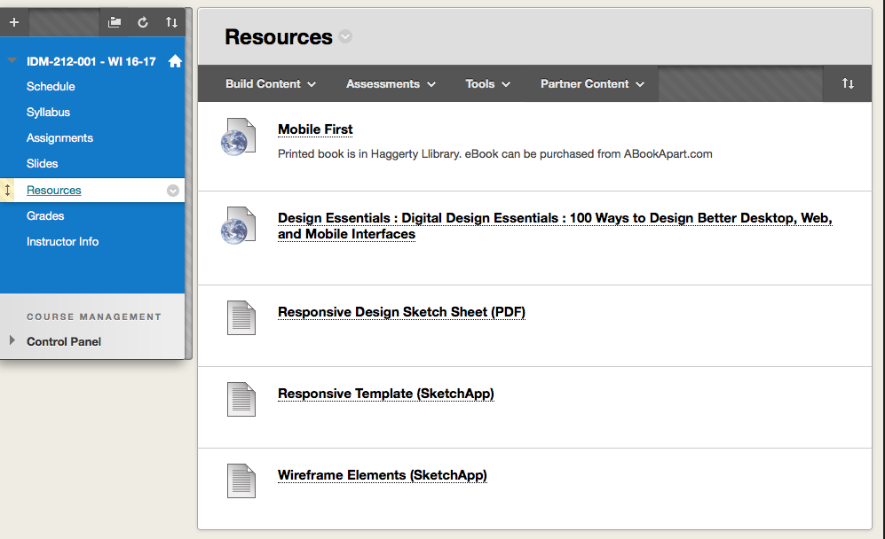

Slide 36
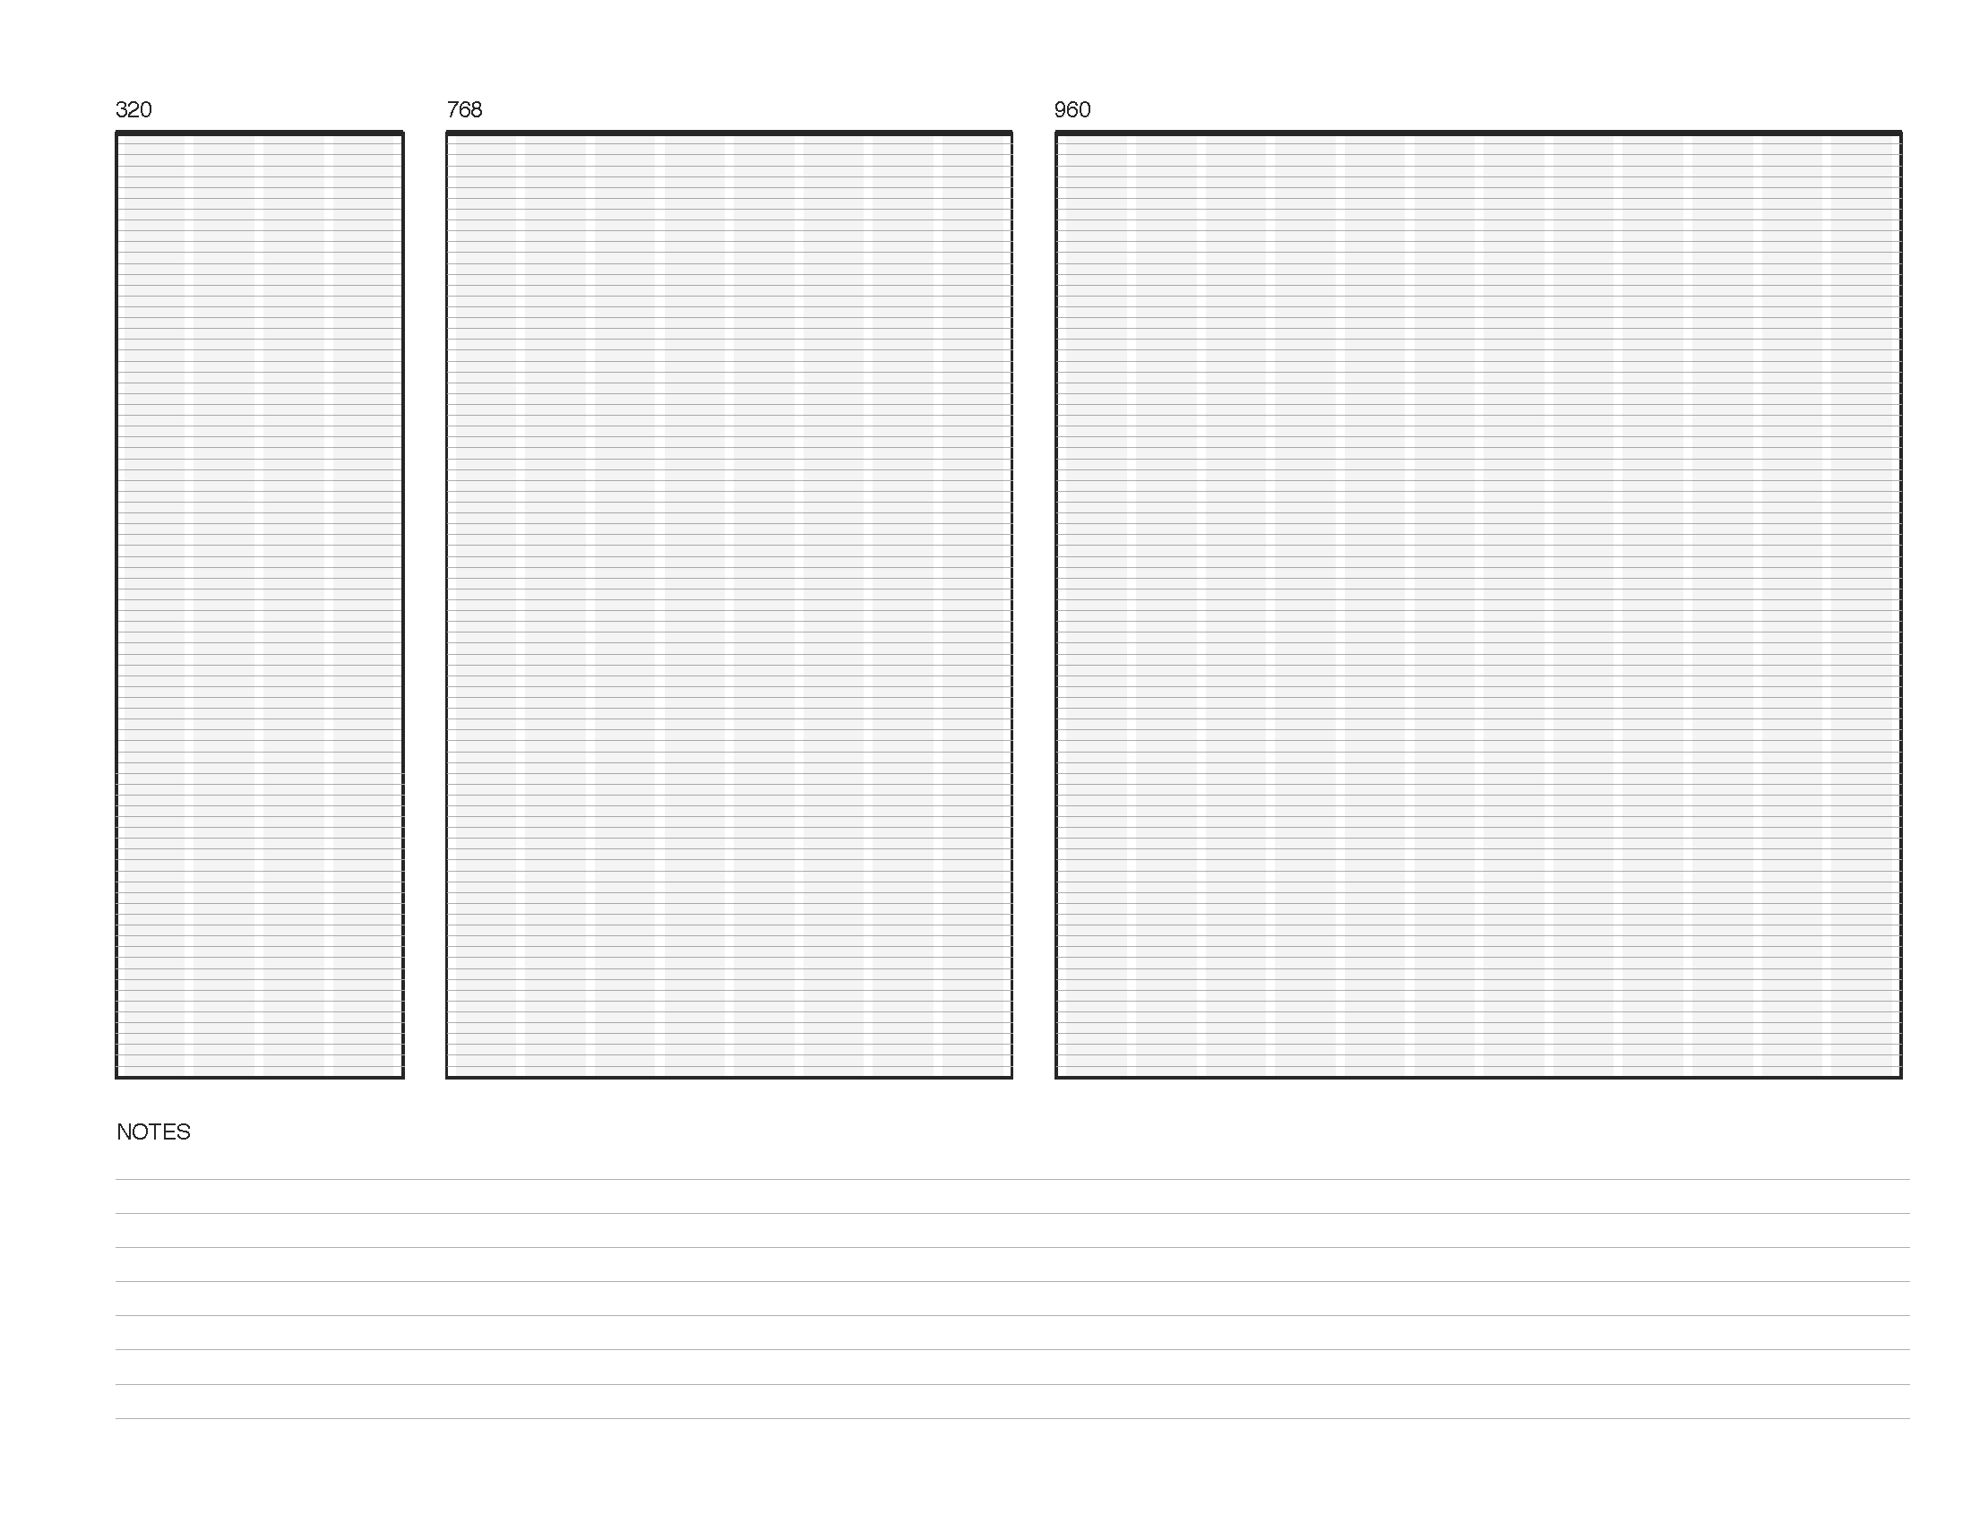

Slide 37

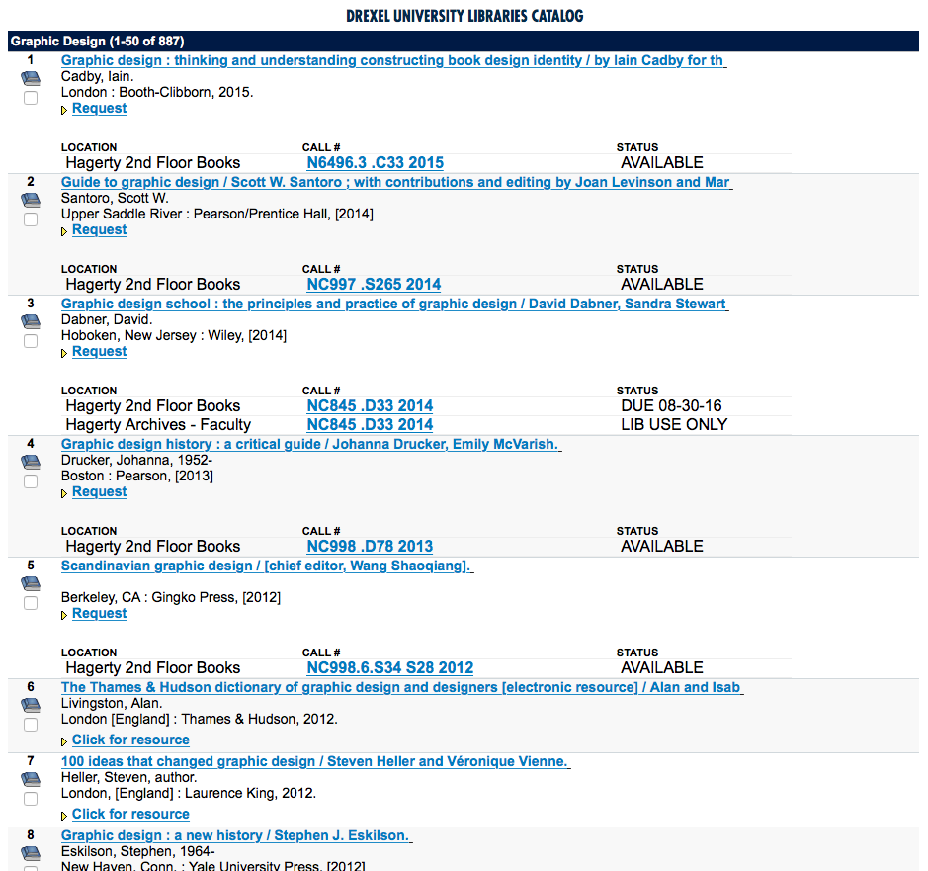
Notes:
Design annuals and books are a good place to start
Haggerty library has many on their shelves.

Slide 38
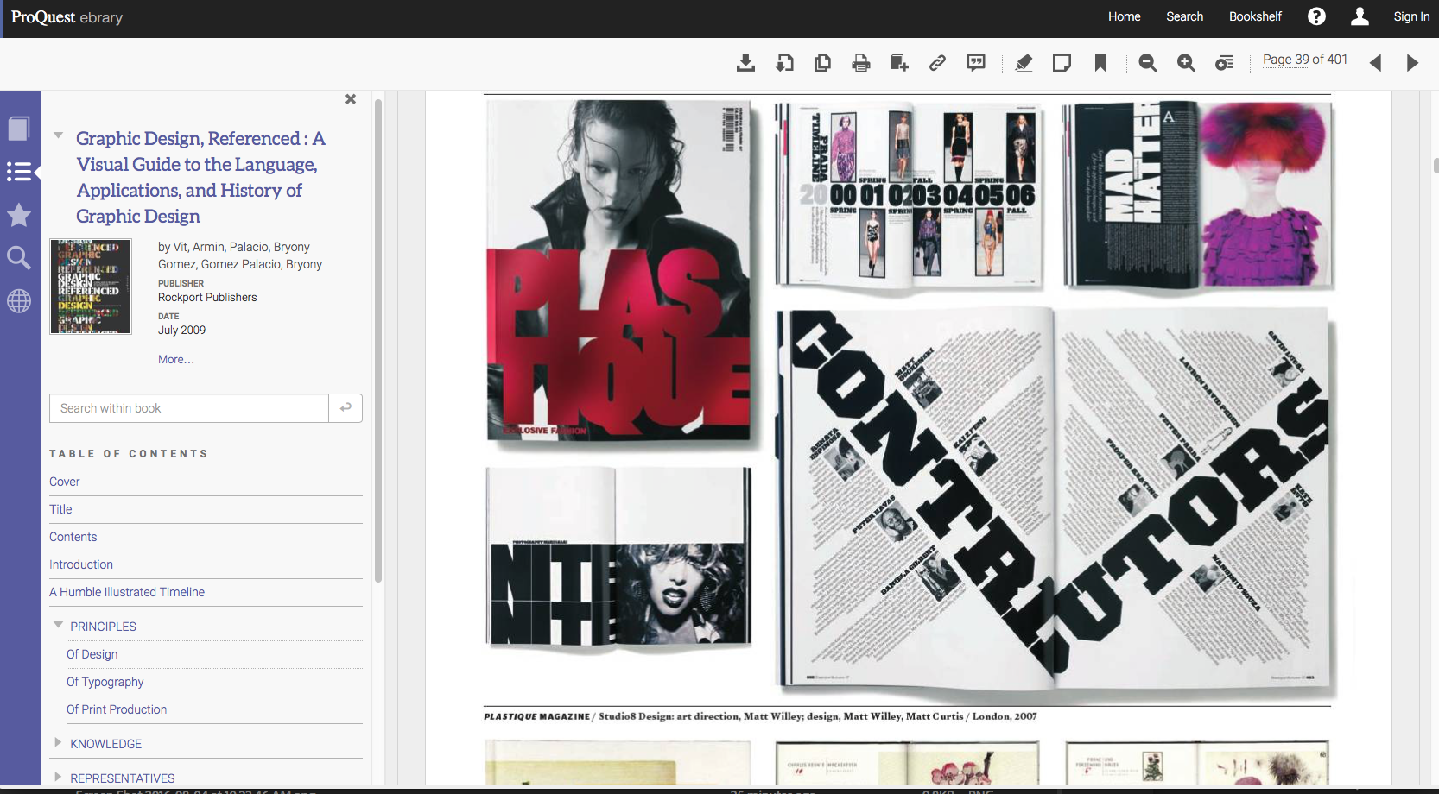
Notes:
Many are even available as eresources through haggerty

Slide 39
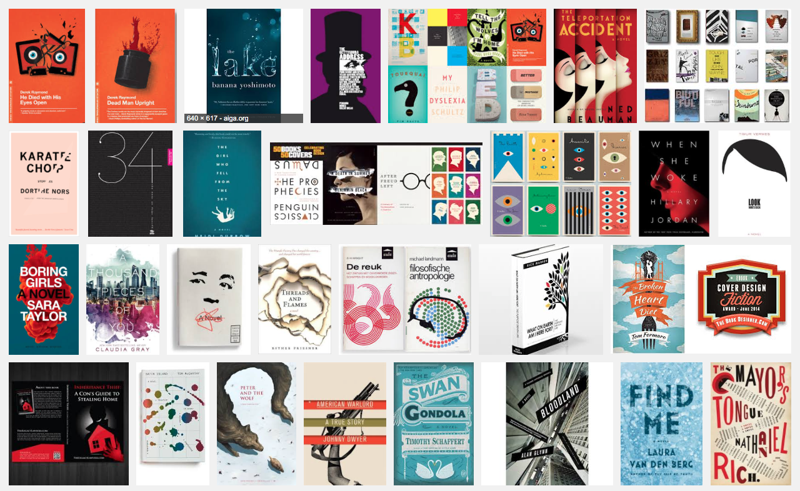
Book Cover Design

Slide 40
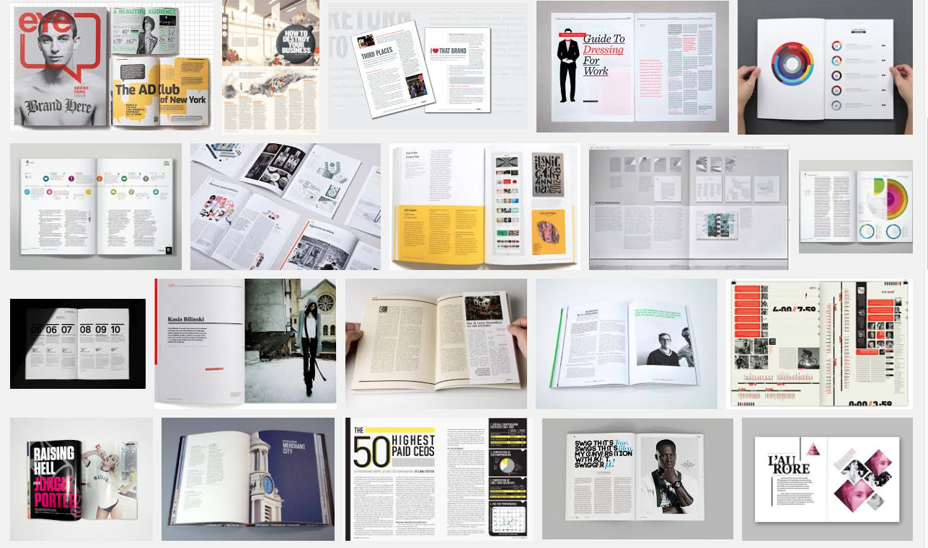
Editorial Design

Slide 41
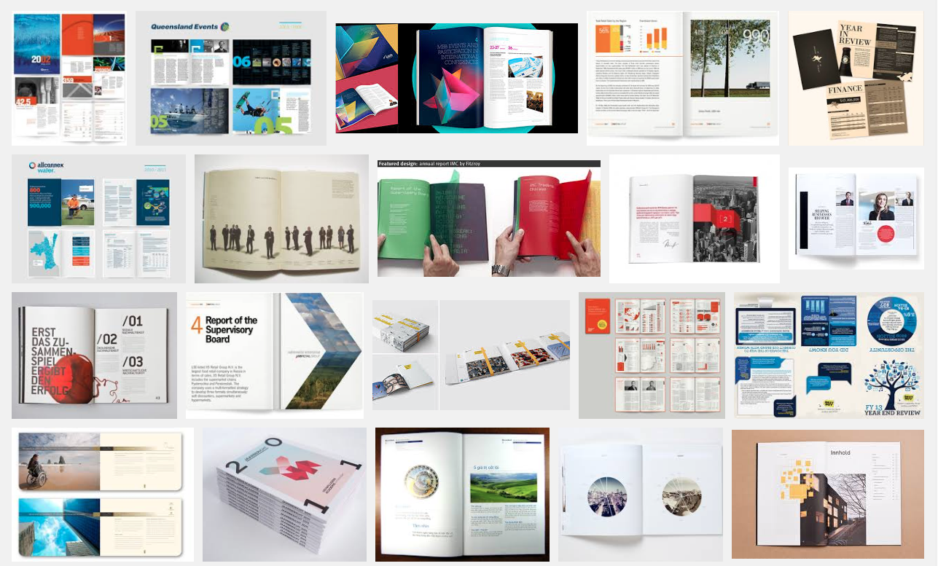
Annual Report Design

Slide 42
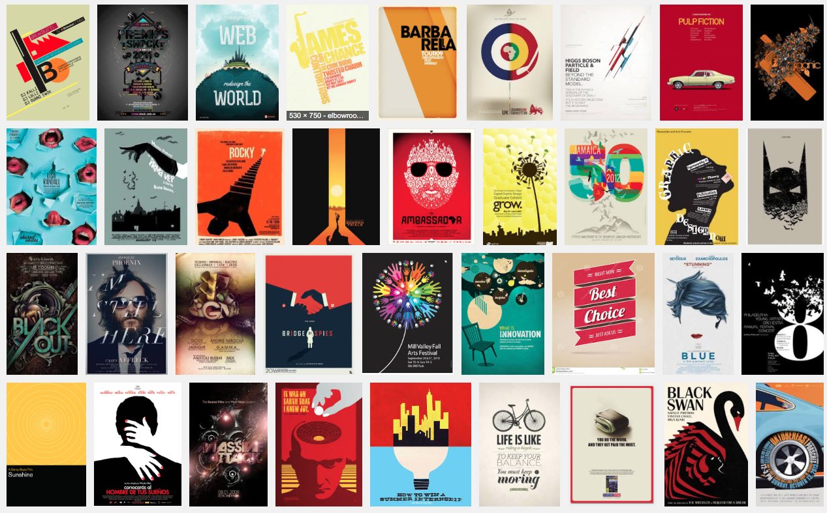
Poster Design

Slide 43
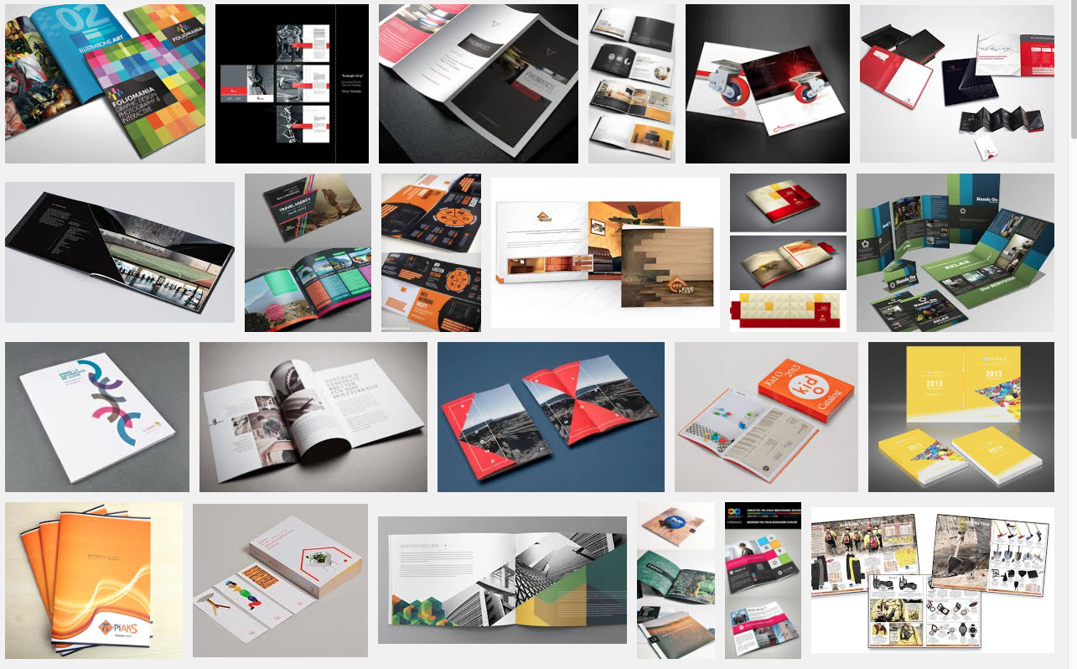
Catalog Design

Slide 44
More Design Inspiration
patterntap.com
niice.com
mediaqueri.es
unmatchedstlye.com/gallery
siteinspire.com
dribbble.com

Slide 45

Sketching Cheat Sheet
Notes:
This is about all the detail you need right now. Look for a design that speaks to you, one that feels like it has the design ethos needed for you project and quickly sketch how if you used this design system to determine the look for your new design how will it influence the layouts?

Slide 46
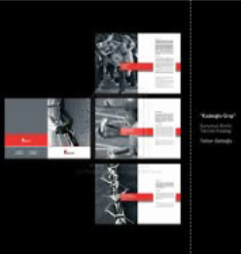

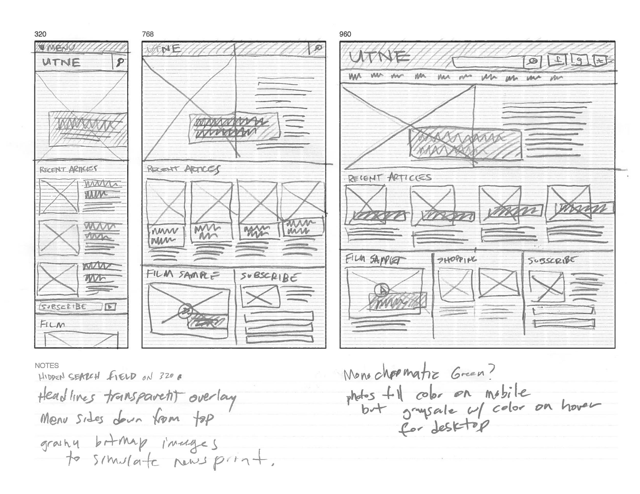
inspiration!
Print out 8 sheets
Find inspiration
use a pencil
sketch fast
repeat
Right now it is about ideas, not pixel perfect details.
Needs to be legible.
Notes:
Print put the sheets, use a pencil, sketch fast. Right now it is about ideas, not details.

Slide 47
Assignment 01: Project Definition Presentation
Be prepared to discuss:
The topic of your chosen product (Brand Name, brand position)
Who will use the product (user persona)
The unique selling points of the product (brand personality)
Your presentation must include:
Images of Home page and 1 article page for three main break points
Wireframes of each page at each breakpoint
User persona
sketches of possible new layouts (min 8)
http://learn.drexel.edu
Notes:
you will be stopped at 3min exactly whether you are finished or not.
Think about your project like powerpoint. How many templates do you need for your project.
You do not need to wireframe every single page, just the differing layouts.
You will need to build each page to create the prototype though.

Slide 48
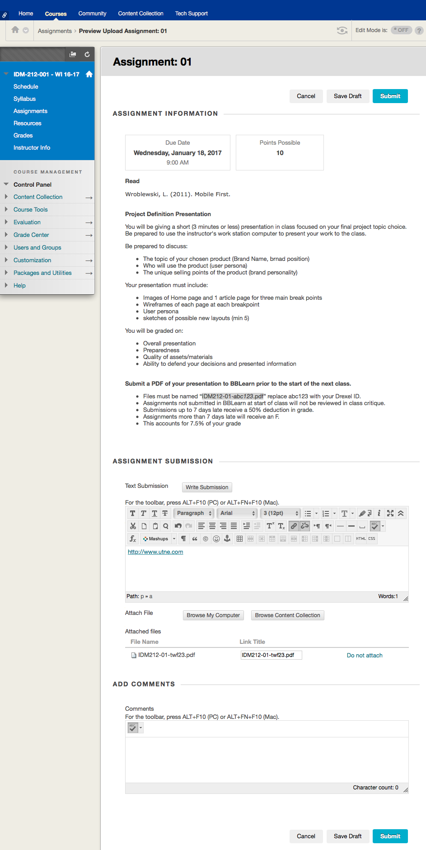
Click on "Write Submission"
Enter URL in textbox
Click on link and enter url again to make it clickable
Attach pdf of presentation
(make sure you name the file correctly)

Slide 49
SAMPLE PRESENTATION…
Keep it simple. 8 pages.

Slide 50

Utne Reader is a digest of the new ideas and fresh perspectives percolating in arts, culture, politics, and spirituality. A combination of original writing and reprints gleaned from books, journals, and the independent media at large
utne.com
Chester Cunanan
Notes:
Define the subject matter

Slide 51
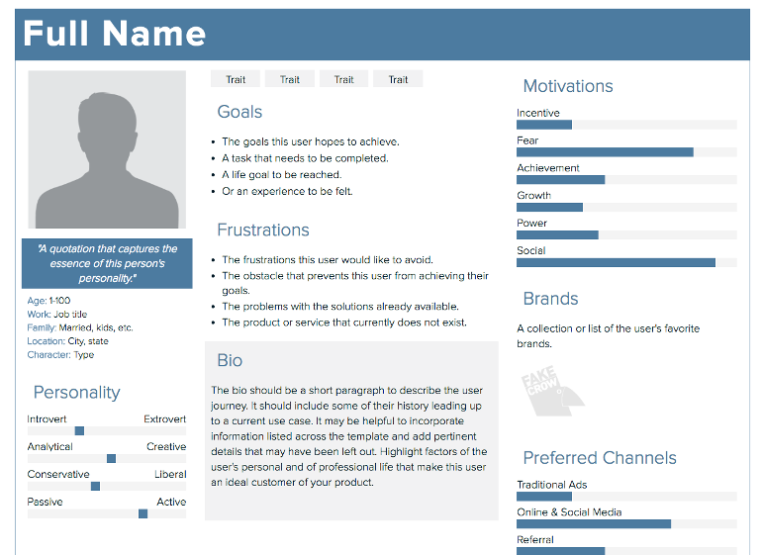
Who reads UTNE?
Utne readers are enthusiastic and motivated agents of social change who want to spend their time and resources making the world a better place. They crave a well-rounded perspective on current events that moves beyond the headlines and soundbites.
utne.com
Notes:
Define the main reader

Slide 52
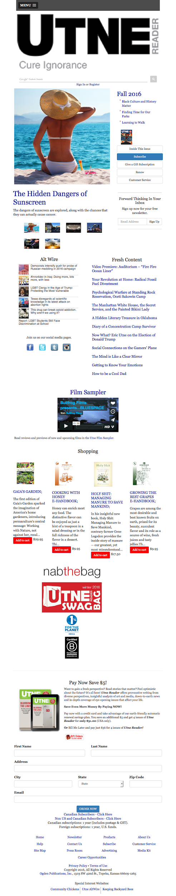
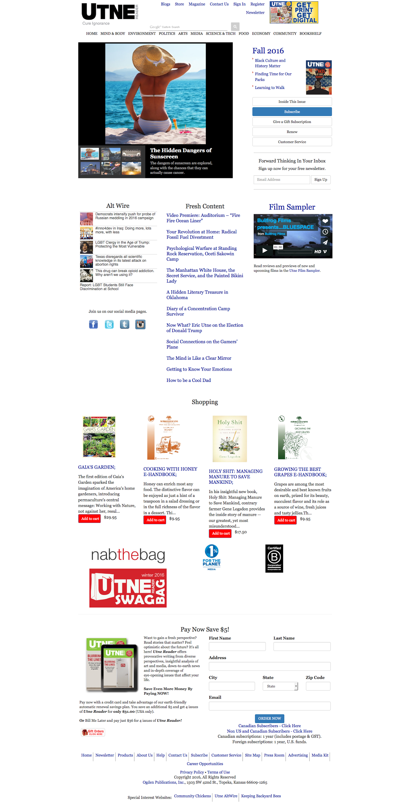
utne.com home page
Notes:
Show screen grabs of current home page

Slide 53
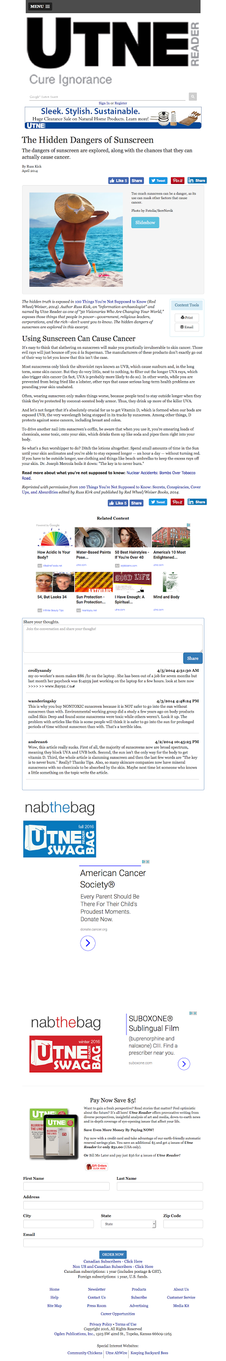
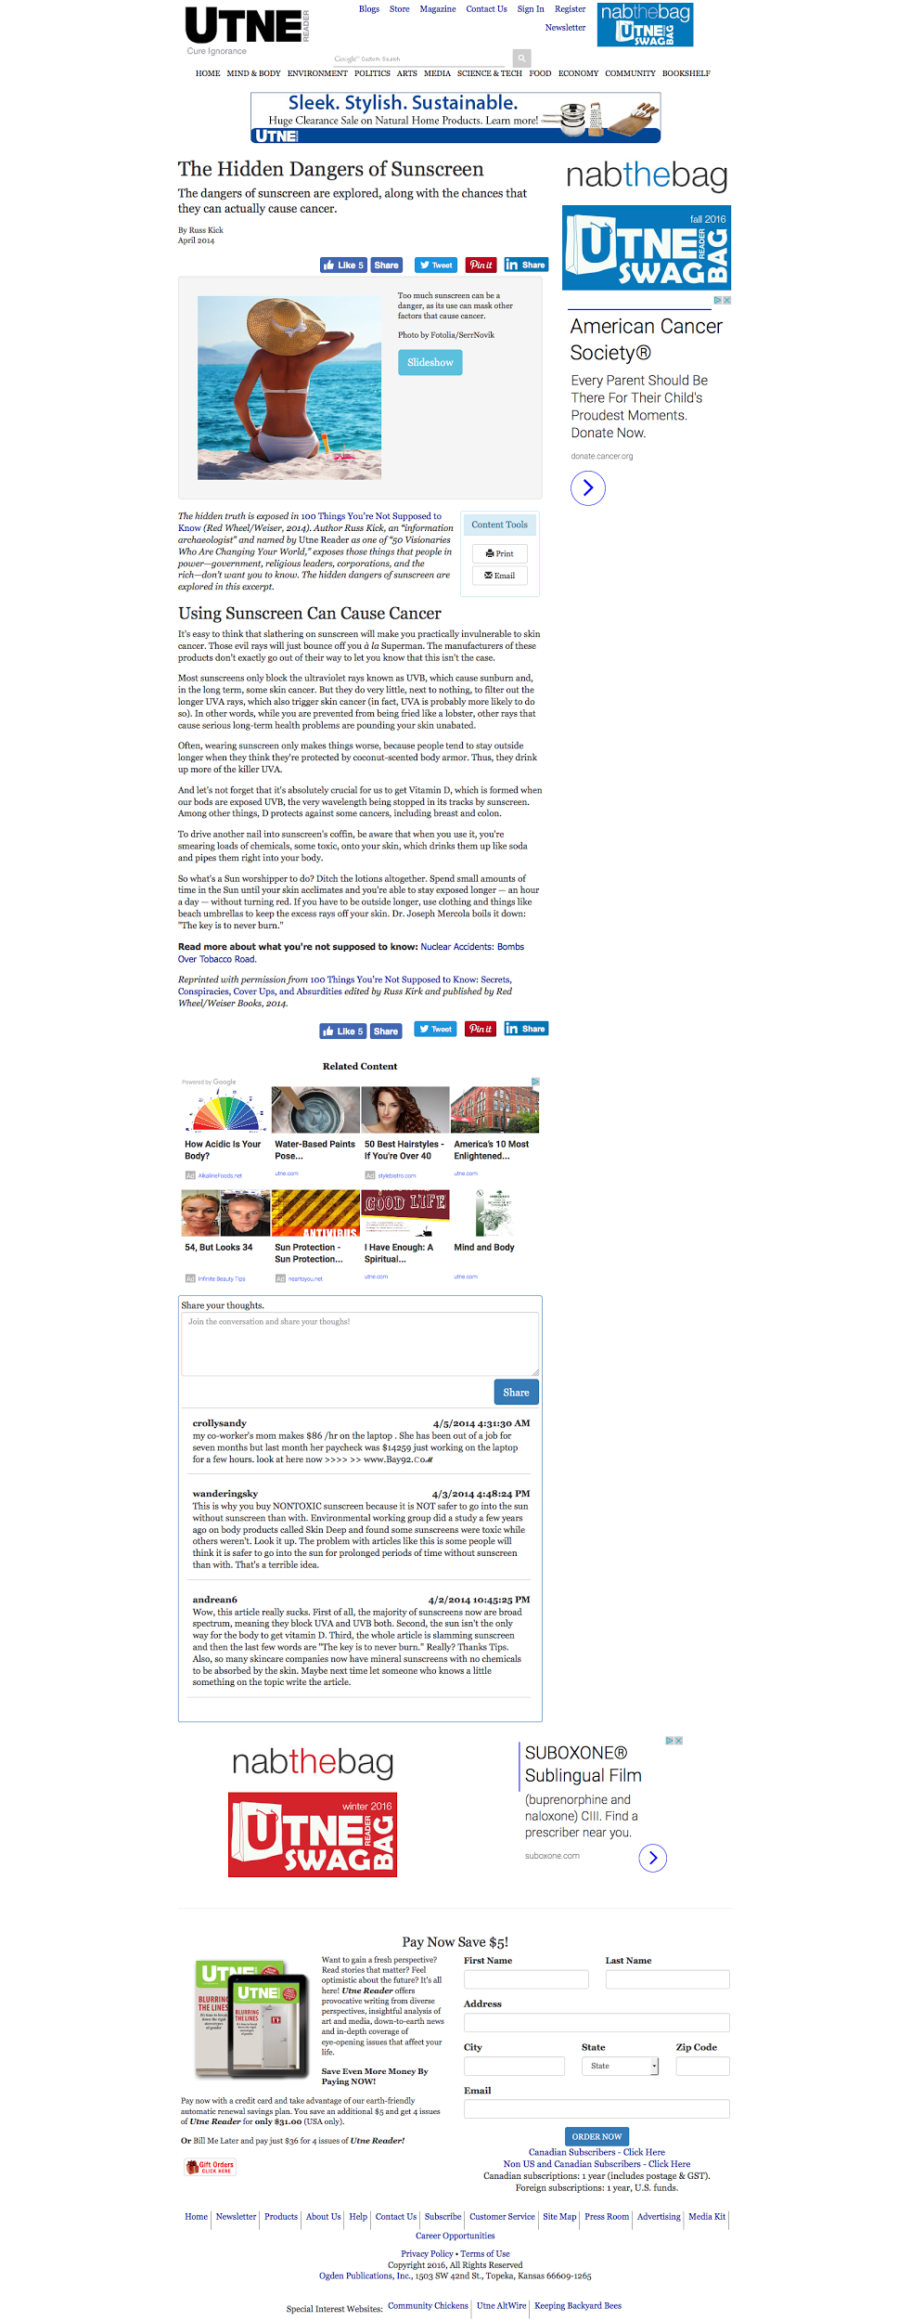
utne.com article page
Notes:
Show screen grabs of current home page

Slide 54
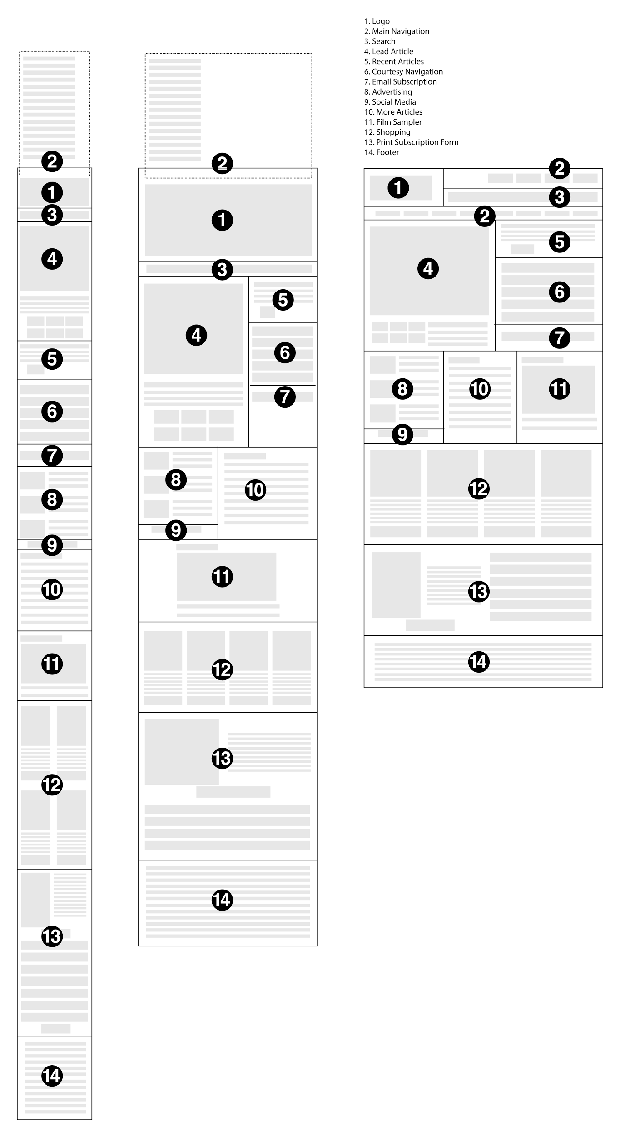
utne.com home page
utne.com article page
Note: In your presentation file, these wireframes should be full size, not scaled down to fit the slideshow window height.
Notes:
Note: obviously not this small, because this is unreadable.

Slide 55
1
2
3
4
Notes:
Obviously yours will show 8 unique layouts, 4 per page = 2 pages

Slide 56
5
6
7
8
Notes:
Obviously yours will show 8 unique layouts, 4 per page = 2 pages

Slide 57
Screen Size Summary
Desktop: 960, 1200, 1366x768
Tablet: 768x1024
Mobile: 360x640
http://gs.statcounter.com/screen-resolution-stats

